Slide 1
Memory Hierarchy
Acknowledgment: Professor Milos Prvulovic, GATECH

Slide 2
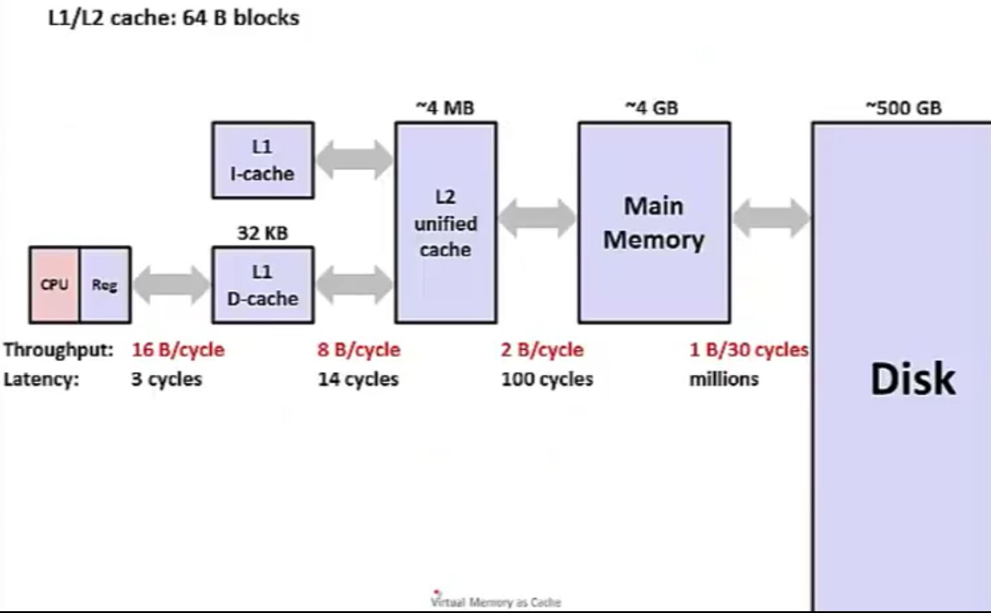
Memory Hierarchy: Core 2 Duo (not drawn to scale)
Source: UW Course in HW/SW Interface (Coursera)

Slide 3
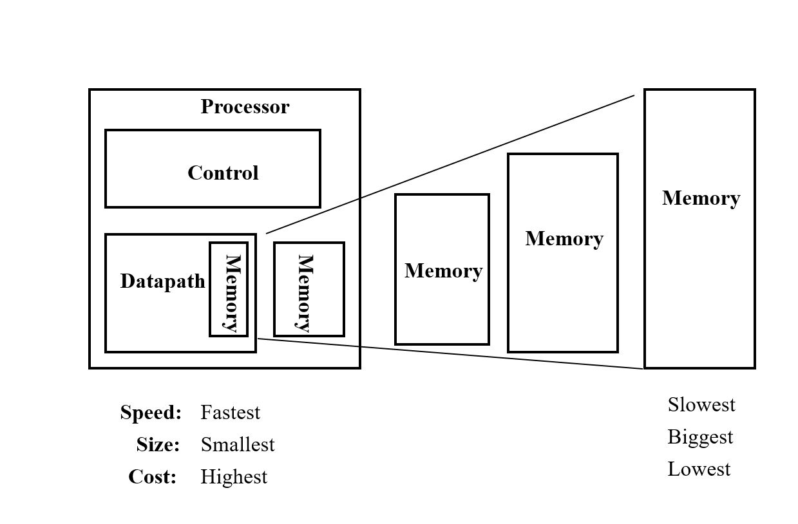
The Case for Memory Hierarchy
Part of memory hierarchy that starts with Registers at the Lowest Level closest to the CPU and ends with the Disk Drive that is furthest from the CPU.
Memory Hierarchy works because it harnesses the two principles of locality
Temporal Locality
Spatial Locality
Facilitates the vision of realizing the “fastest” “infinite” memory

Slide 4
Principles of Locality
Temporal Locality: If an address has been accessed recently, it will likely be accessed again.
Spatial Locality: If an address has been accessed, it is likely addresses close to it will be accessed.

Slide 5
Temporal and spatial locality
int sum = 0;
for (int j = 0; j<1000; j++)
sum = sum + arr[j];
What portion of this code shows temporal locality?
What portion of this code shows spatial locality?

Slide 6
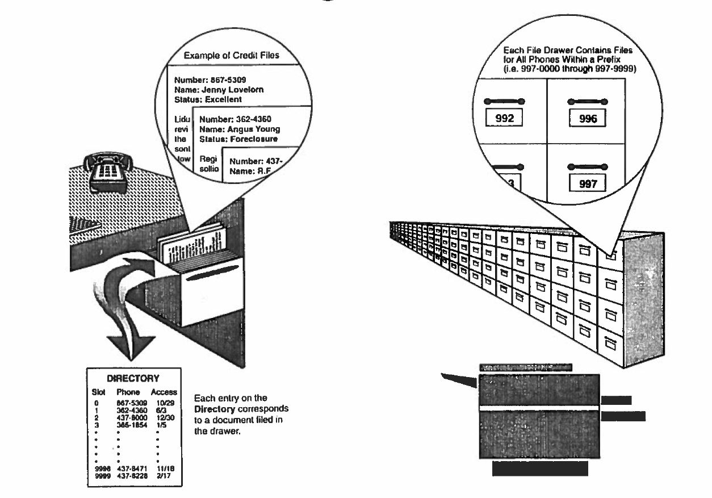
Workings of a Cache Memory
Source: Jim Handy, The Cache Book

Slide 7

Cache Lookups
Size of memory grows as it gets further away from the CPU. It also gets slower.
A cache is a small memory for fast data lookup, to save the time that would be spent going to main memory
Principles of locality give us guidance on what content to store in the cache

Slide 8
Cache Lookups
Since cache is small, not all the data will fit, so one of two things happen when we access the cache:
HIT: the data we are looking for IS in the cache
MISS: the data we are looking for is NOT in the cache
Cache hits return the data fast
Cache misses are slow because they have to go to the next level of storage
So it behooves us to design caches to have as few misses as possible.

Slide 9
Cache Hierarchy in Processors
Machines
PC, Laptop: L1 → L2 → Main Memory
Servers: L1 → L2 → L3 or LLC → Main Memory
L1 Cache Directly services Read/Write Requests from the processor. One can have a Unified L1 for Code and Data or Separate L1’s for Data and Code
L2 Cache: Serves L1 Misses (otherwise go to LLC)
LLC Cache: Serves L2 Misses (otherwise go to Main Memory)
Size of caches is critical tradeoff between access time (requires small cache) and hit rate ( requires large cache)

Slide 10
Cache Organization
TAG
Source: Jim Handy, The Cache Book

Slide 11
Blocks and lines
MEMORY
15
14
CACHE
3
BLOCKS
2
LINES
1
0
Blocks in memory correspond to Lines in Cache
A given block (line) can be 1 or more Bytes
→ example: above case blocks (lines) have 4 Bytes
→ Memory has 16 blocks, cache has 4 lines
2
1
0

Slide 12
Block Offset and Block Number

Slide 13
Block Composition Quiz

Slide 14
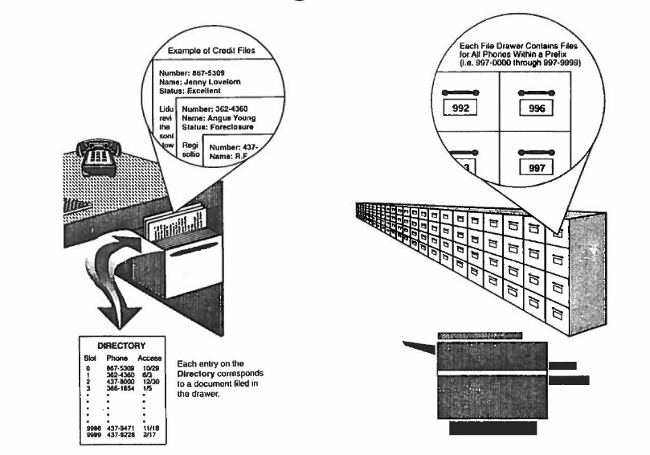
Cache Tags

Slide 15
Valid Bit

Slide 16
Practice Questions
How many lines are in a 4KB cache with 32B line size?
In a 32-bit address 0xABCDEF56 what is the block number and byte offset for 64-byte block size?

Slide 17
Memory to Cache – Questions
BLOCKS
15
14
LINES
3
2
1
0
CACHE
How many blocks can be brought to the cache?
→ 4 because that is the capacity of the cache
Which blocks get mapped to which lines in the cache?
→ Depends on the scheme
2
1
0
MEMORY

Slide 18
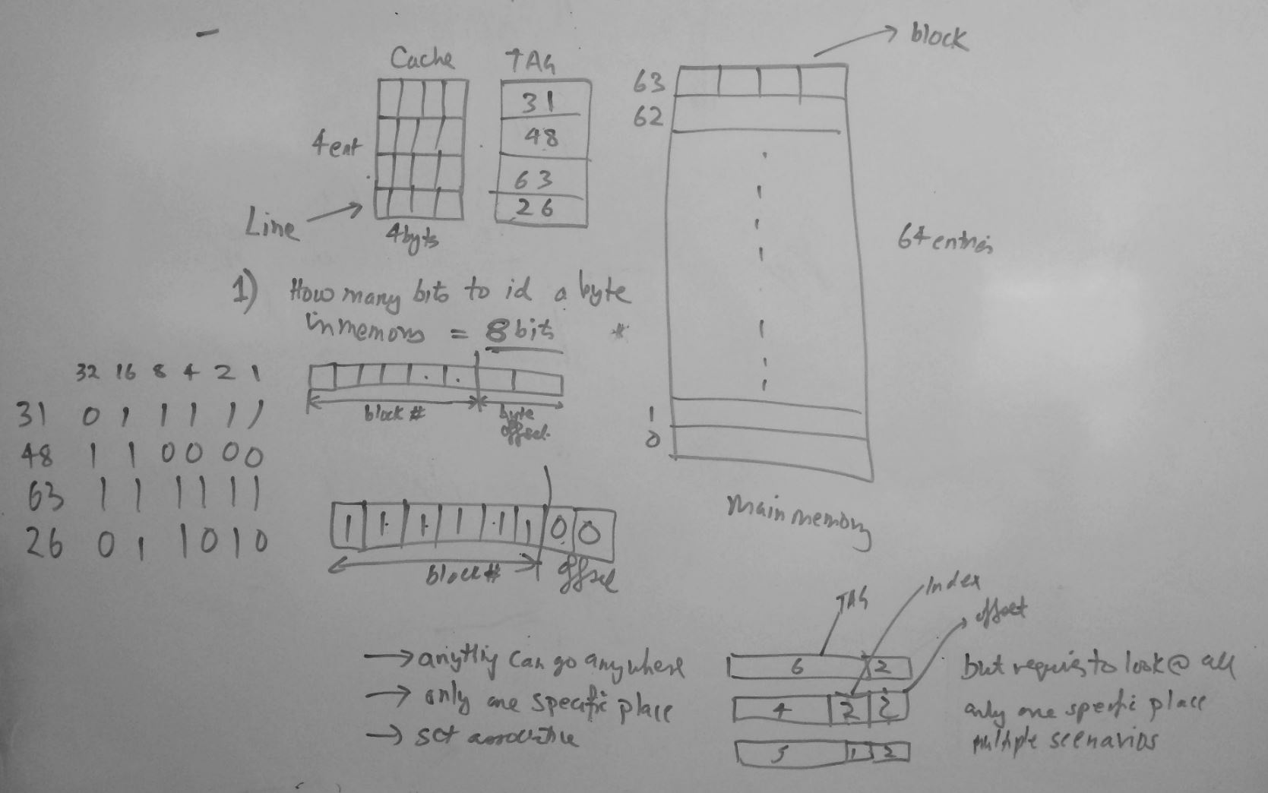
Example

Slide 19
Cache Organization
Fully Associative – any block can be in any given line
Direct Mapped – a block can only go to only one particular line
Set Associative (SA) – any one of the “n” lines where a block can go
1-way SA cache will mean direct mapped cache
N-way SA cache where each set contains N locations (lines) where a block can go
BLOCKS
15
14
LINES
3
2
1
0
CACHE
2
1
0

Slide 20
Direct Mapped Cache
Mapping is modulo-4 in this example

Slide 21
Direct Mapped Cache Quiz
0101 0110 0111 1000
256 B block will translate to lowest 8 bits for block offset
16KB cache will have 2^14/2^8 = 2^6 = 64 blocks = 6bits
Notes:
123456 will match the block number for the address so the 1st choice is not a conflict because they map to the same address

Slide 22
Set Associative Cache

Slide 23
Set Associative Cache Quiz
32 B Line Size
2 way SA cache. Address access pattern
0xF563
0xEF63
What is the final content of the cache?
0xF303
0xF503
32B

Slide 24
Determining Offset and Index

Slide 25
Cache Organization
Source: Jim Handy, The Cache Book

Slide 26
Cache Line Replacement
Let’s say a Set is full a new address request goes to the Set resulting in a Miss
Miss → Need to bring a new block in the Cache
Which line in the set do we kick out?
Common techniques are
Random
First in First out
Least Recently Used (LRU)

Slide 27
LRU Implementation
Basic Idea is to look for the oldest accessed line to kick out? Why?
Implementation: Attach a counter to each line. Line with the lowest count is the eviction candidate.

Slide 28
Example

Slide 29
Example (contd.)

Slide 30
Write Policy for Write Miss
Do we cache the blocks we write?
No-Write-Allocate: On write miss, just write to the memory and not cache the block.
Write Allocate: Every time there is a write miss, bring the block to the cache as well. Why?
To take advantage of locality between writes and read i.e. cache the block with the expectation that it will be read again soon

Slide 31
Write Policy for Write Hits
Do we write just to the cache or also to memory?
Write-Through: Update memory every time a write to cache occurs
Write-Back: Update memory only when a written entry (line) in cache is getting evicted or replaced

Slide 32
Write-Back Cache
To implement this, we append a “Dirty” bit to every cache line
Dirty Bit =1 indicates the line was written to and therefore needs to be updated in the main memory at replacement
Dirty Bit = 0 indicates the line was not written to and can be simply replaced without any updates to the main memory

Slide 33
Write-Back Cache Practice Question
Notes:
Cache Line: final values are 1 1 D
Total 4 Misses
1 Write Back

Slide 34
Summary
Memory Hierarchy is needed to assist in the creation and maintenance of the illusion of infinite and fastest storage
Caching is the most critical concept behind this illusion and relies on principles of locality
Caches are organized as direct mapped or fully associative or set associative

Slide 35
Summary
Handling misses are time consuming therefore miss rate must be minimized
The size of cache, number of ways and line size are important parameters designed to maximize the chances of finding the address i.e. ‘hit rate’
LRU is a popular algorithm used to determine which cache line to evict in the event of an address conflict
Cache write policies can be ‘write back’ or ‘write through’ depending on traffic

